Slide 1


CSE 470 – Layered Architecture
BRAC University

Slide 2




Lets recall Monolithic Software
The end product come at end of the process model
There is no separation of concern (code) of different software components.
All code may be written in a single file with html, sql queries, logic checking etc.
Customer Screen, Browser, Keyboard input
Read/ write data on the storage
Operation on data – validate, aggregate, calculate
Actual residence of data

Slide 3
No separation between components
Changing a component affects other components. For example – What if I want to change the UI from JavaScript to Angular ?

Slide 4
Layered Architecture
Organises the system into a set of layers (or abstract machines) each of which provide a set of services.
Supports the incremental development of sub-systems in different layers. When a layer interface changes, only the adjacent layer is affected.

Slide 5
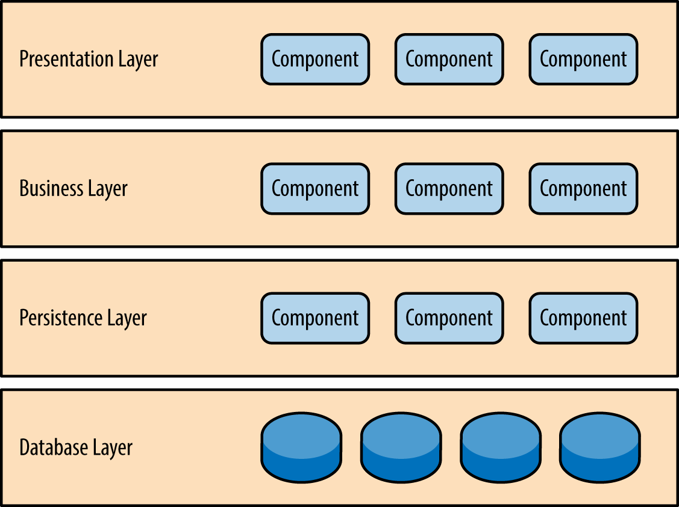
Organizes the system into layers with related functionality associated with each layer.
A layer provides services to the layer above it so the lowest-level layers represent core services that are likely to be used throughout the system.

Slide 6
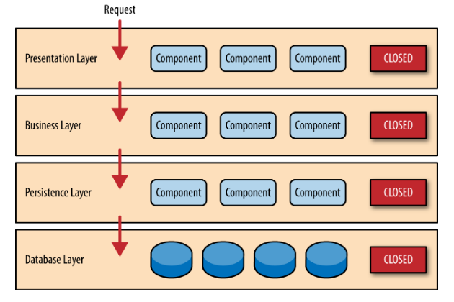
Layers can be open or closed
A closed layer can only be accessed by the layer above.
A change in one layer does not affect others. It provides isolation.
However, what if we want to add a new layer where shared utilities will be provided to be used by the Business Layer. But, we need to use it sometimes.

Slide 7
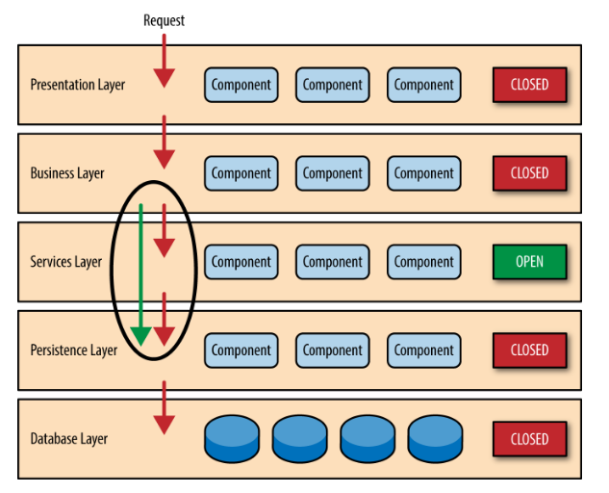
Here comes the concept of open layers.
An open can be bypassed by upper layers.
Too many open layers may affect the actual essence of layered architecture.

Slide 8
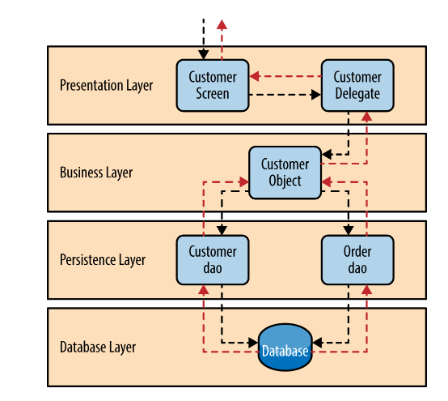
Example !!

Slide 9
When Used:
Used when building new facilities on top of existing systems
When the development is spread across several teams with each team responsibility for a layer of functionality
When there is a requirement for multi-level security.
Advantages:
Allows easy replacement or addition of entire layers so long as the interface is maintained.
Testing is easy as components are isolated
Disadvantages:
In practice, providing a clean separation between layers is often difficult and a high-level layer may have to interact directly with lower-level layers rather than through the layer immediately below it.
Performance can be a problem because of multiple levels of interpretation of a service request as it is processed at each layer.
A change in any layer still requires to restart the application.

Slide 10
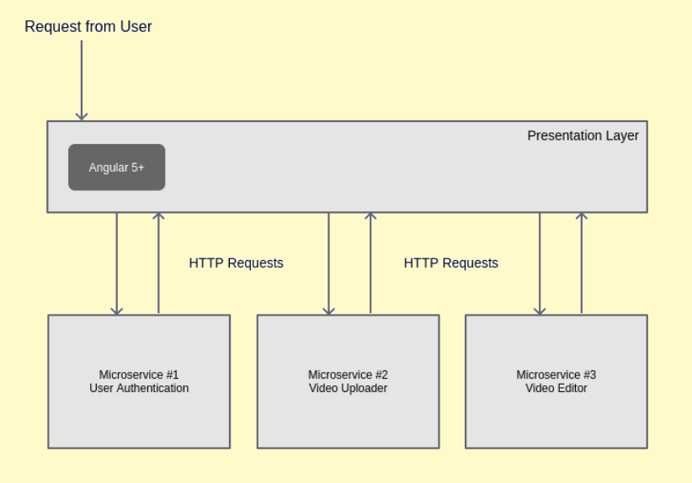
Microservices

